Slide 1
UNIT IV: Probability Densities
The Uniform Distribution,
Log-normal distribution,
Beta distribution,
Gamma distribution

Slide 2
The Uniform Distribution

Slide 3
What Is Uniform Distribution?
In statistics, uniform distribution refers to a type of probability distribution in which all outcomes are equally likely.
A deck of cards has within it uniform distributions because the likelihood of drawing a heart, a club, a diamond, or a spade is equally likely.
A coin also has a uniform distribution because the probability of getting either heads or tails in a coin toss is the same.
The uniform distribution can be visualized as a straight horizontal line, so for a coin flip returning a head or tail, both have a probability p = 0.50 and would be depicted by a line from the y-axis at 0.50.

Slide 4
What Is Uniform Distribution?
In a discrete uniform distribution, outcomes are discrete and have the same probability.
In a continuous uniform distribution, outcomes are continuous and infinite.
In a normal distribution, data around the mean occur more frequently.
The frequency of occurrence decreases the farther you are from the mean in a normal distribution.

Slide 5
Understanding Uniform Distribution
There are two types of uniform distributions: discrete and continuous.
The possible results of rolling a die provide an example of a discrete uniform distribution: it is possible to roll a 1, 2, 3, 4, 5, or 6, but it is not possible to roll a 2.3, 4.7, or 5.5.
Therefore, the roll of a die generates a discrete distribution with p = 1/6 for each outcome. There are only 6 possible values to return and nothing in between.

Slide 6
Understanding Uniform Distribution
Some uniform distributions are continuous rather than discrete.
An idealized random number generator would be considered a continuous uniform distribution. With this type of distribution, every point in the continuous range between 0.0 and 1.0 has an equal opportunity of appearing, yet there is an infinite number of points between 0.0 and 1.0.

Slide 7
Visualizing Uniform Distributions
A distribution is a simple way to visualize a set of data. It can be shown either as a graph or in a list, revealing which values of a random variable have lower or higher chances of happening.
Under a uniform distribution, each value in the set of possible values has the same possibility of happening. When displayed as a bar or line graph, this distribution has the same height for each potential outcome. In this way, it can look like a rectangle and therefore is sometimes described as the rectangular distribution.

Slide 8
Visualizing Uniform Distributions
If you think about the possibility of drawing a particular suit from a deck of playing cards, there is a random yet equal chance of pulling a heart as there is for pulling a spade—that is, 1/4 or 25%.
The roll of a single dice yields one of six numbers: 1, 2, 3, 4, 5, or 6. Because there are only 6 possible outcomes, the probability of you landing on any one of them is 16.67% (1/6). When plotted on a graph, the distribution is represented as a horizontal line, with each possible outcome captured on the x-axis, at the fixed point of probability along the y-axis.

Slide 9
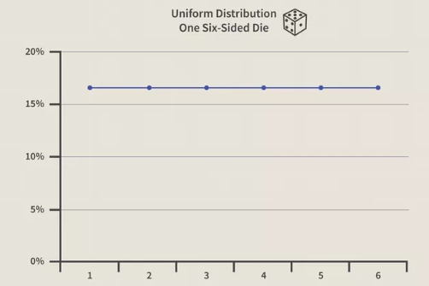
Visualizing Uniform Distributions

Slide 10
Example of Uniform Distribution
There are 52 cards in a traditional deck of cards. In it are four suits: hearts, diamonds, clubs, and spades. Each suit contains an A, 2, 3, 4, 5, 6, 7, 8, 9, 10, J, Q, K, and 2 jokers. However, we'll do away with the jokers and face cards for this example, focusing only on number cards replicated in each suit. As a result, we are left with 40 cards, a set of discrete data.
Suppose you want to know the probability of pulling a 2 of hearts from the modified deck. The probability of pulling a 2 of hearts is 1/40 or 2.5%. Each card is unique; therefore, the likelihood that you will pull any one of the cards in the deck is the same.
Now, let's consider the likelihood of pulling a heart from the deck. The probability is significantly higher. Why? We are now only concerned with the suits in the deck. Since there are only four suits, pulling a heart yields a probability of 1/4 or 25%.

Slide 11
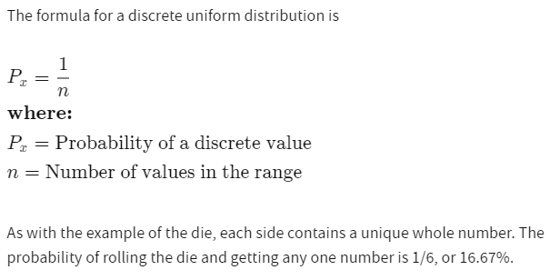
Formula for Uniform Distribution

Slide 12
Log-normal distribution

Slide 13
Log-normal Distribution
The log-normal distribution is a right skewed continuous probability distribution, meaning it has a long tail towards the right.
It is used for modelling various natural phenomena such as income distributions, the length of chess games or the time to repair a maintainable system and more.

Slide 14
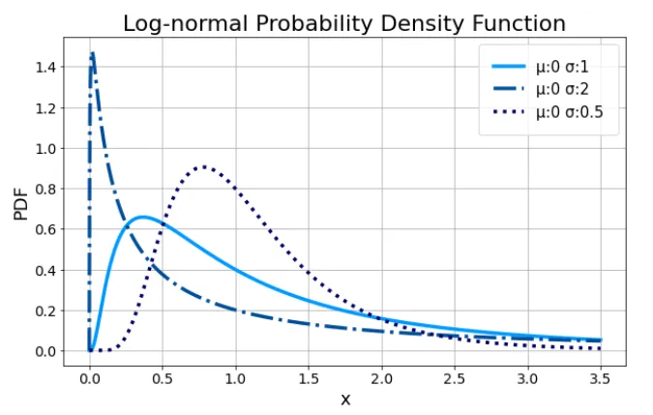
Log-normal Distribution

Slide 15
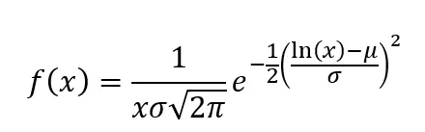
Log-normal Distribution
The probability density function for the log-normal is defined by the two parameters μ and σ, where x > 0:
μ is the location parameter and σ the scale parameter of the distribution.

Slide 16
Applications and Uses of Log-Normal Distribution in Finance
Normal distributions may present a few problems that log-normal distributions can solve. Mainly, normal distributions can allow for negative random variables while log-normal distributions include all positive variables.
One of the most common applications where log-normal distributions are used in finance is in the analysis of stock prices.
The potential returns of a stock can be graphed in a normal distribution.
The prices of the stock, however, can be graphed in a log-normal distribution. The log-normal distribution curve can therefore be used to help better identify the compound return that the stock can expect to achieve over a period of time.

Slide 17
Beta distribution

Slide 18
Beta distribution
The Beta distribution is a type of probability distribution which represents all the possible value of probability
In probability and statistics, the Beta distribution is considered as a continuous probability distribution defined by two positive parameters
It is a type of probability distribution which is used to represent the outcomes or random behaviour of proportions or percentage.
The three-point technique, which is also called the beta distribution technique, is used to recognize the uncertainty in the estimated project time. It provides powerful quantitative tools to identify the tasks which are having the greatest risk. It also manages the time for project completion.

Slide 19
Beta Distribution Definition
The beta distribution is a family of continuous probability distributions set on the interval [0, 1] having two positive shape parameters, expressed by α and β. These two parameters appear as exponents of the random variable and manage the shape of the distribution.

Slide 20
Beta Distribution Notation
It is defined on the interval [0,1] denoted by α and β, usually. α and β are two positive parameters that appear as exponents of the random variable and is intended to control the shape of the distribution. Its notation is Beta(α,β), where α and β are the real numbers, and the values are more than zero.

Slide 21
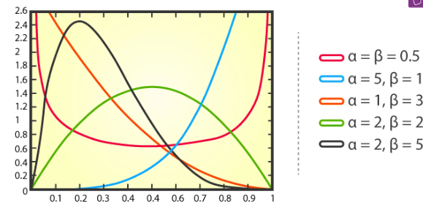
Beta Distribution Notation

Slide 22
Beta Distribution Formula
The beta distribution is used to check the behaviour of random variables which are limited to intervals of finite length in a wide variety of disciplines.
The characterization of this distribution is basically defined as Probability Density Function, Cumulative Density Function, Moment generating function, Expectations and Variance and its formulas are given below.

Slide 23
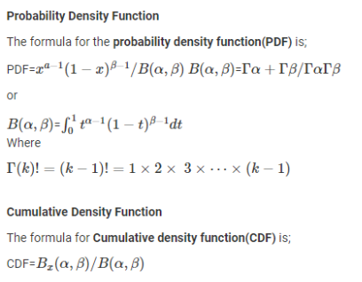
Beta Distribution Formula

Slide 24
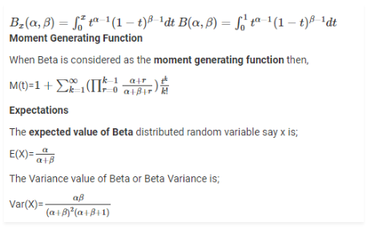
Beta Distribution Formula

Slide 25
Properties
Some of the properties that satisfy the distribution are as follow:
The measure of central tendency. They are:
Mean
Median
Mode
Geometric Mean
Harmonic Mean
The measure of statistical dispersion, such as:
Variance
Geometric variance and covariance
Mean absolute difference
Mean absolute deviation around the mean

Slide 26
Beta Distribution Applications
It is used in many applications, that includes
Bayesian hypothesis testing
The rule of succession
Task duration modelling
Project planning control systems like CPM and PERT.

Slide 27
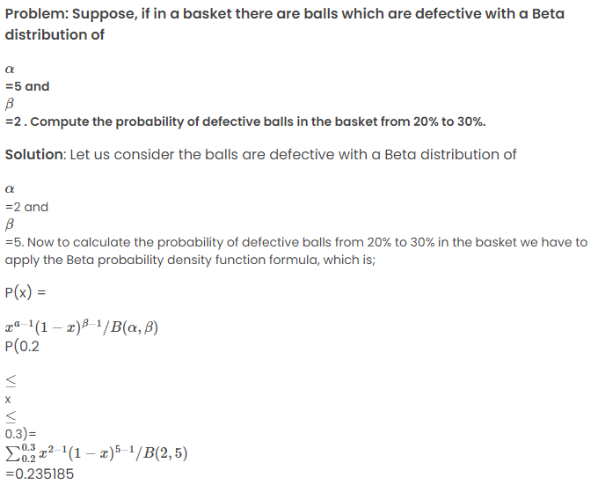
Beta Distribution Example

Slide 28
Gamma distribution

Slide 29
Gamma distribution
Gamma Distribution is one of the distributions, which is widely used in the field of Business, Science and Engineering, in order to model the continuous variable that should have a positive and skewed distribution.
Gamma distribution is a kind of statistical distributions which is related to the beta distribution.
This distribution arises naturally in which the waiting time between Poisson distributed events are relevant to each other.

Slide 30
What is Gamma Distribution?
The gamma distribution term is mostly used as a distribution which is defined as two parameters – shape parameter and inverse scale parameter, having continuous probability distributions.
It is related to the normal distribution, exponential distribution, chi-squared distribution and Erlang distribution. ‘Γ’ denotes the gamma function.
Gamma distributions have two free parameters, named as alpha (α) and beta (β), where;
α = Shape parameter
β = Rate parameter (the reciprocal of the scale parameter)
It is characterized by mean µ=αβ and variance σ²=αβ²
The scale parameter β is used only to scale the distribution. This can be understood by remarking that wherever the random variable x appears in the probability density, then it is divided by β. Since the scale parameter provides the dimensional data, it is seldom useful to work with the “standard” gamma distribution, i.e., with β = 1.

Slide 31
Gamma Distribution Function
The gamma function is represented by Γ(y) which is an extended form of factorial function to complex numbers(real). So, if n∈{1,2,3,…}, then Γ(y)=(n-1)!
If α is a positive real number, then Γ(α) is defined as
Γ(α) = ₀∫∞ ( y^{a-1}e^{-y} dy) , for α > 0.
If α = 1, Γ(1) =₀∫∞ (e^{-y} dy) = 1
If we change the variable to y = λz, we can use this definition for gamma distribution: Γ(α) = ₀∫∞ y^{a-1} e^{λy} dy where α, λ >0.

Slide 32

Gamma Distribution Formula
where p and x are a continuous random variable.

Slide 33
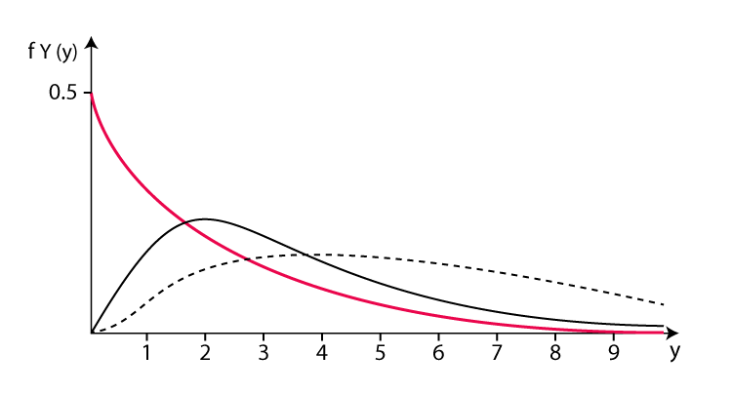
Gamma Distribution Graph
The parameters of the gamma distribution define the shape of the graph. Shape parameter α and rate parameter β are both greater than 1.
When α = 1, this becomes the exponential distribution
When β = 1 this becomes the standard gamma distribution

Slide 34
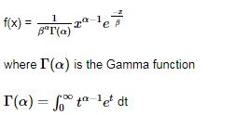
Gamma Distribution of Cumulative Distribution Function
The cumulative distribution function of a Gamma distribution is as shown below:

Slide 35
Gamma Distribution Properties
The properties of the gamma distribution are:
For any +ve real number α,
Γ(α) = ₀∫∞ ( y^{a-1}e^{-y} dy) , for α > 0.
₀∫∞ y^{a-1} e^{λy} dy = Γ(α)/λª, for λ >0.
Γ(α +1)=α Γ(α)
Γ(m)=(m-1)!, for m = 1,2,3 …;
Γ(½) = √π

Slide 36
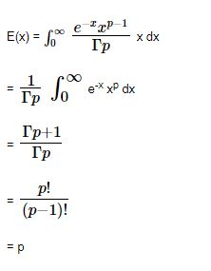
Gamma Distribution Mean
There are two ways to determine the gamma distribution mean
Directly
Expanding the moment generation function
It is also known as the Expected value of Gamma Distribution.

Slide 37
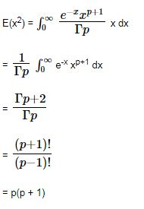
Gamma Distribution Variance
It can be shown as follows:

Slide 38

Gamma Distribution Example
Imagine you are solving difficult Maths theorems and you expect to solve one every 1/2 hour. Compute the probability that you will have to wait between 2 to 4 hours before you solve four of them.
One theorem every 1/2 hour means we would suppose to get θ = 1 / 0.5 = 2 theorem every hour on average. Using θ = 2 and k = 4, Now we can calculate it as follows:

